Slide 1

Executive summary
Of business case

Slide 2
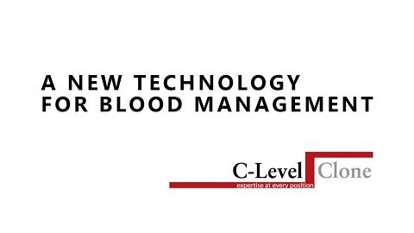
SHORT VIDEO SUMMARIZING OUR GAMING CHANGING TECHNOLOGY

Slide 3
Our markets(PLATELETS,RED CELLS,CONTAMINATES, NO WASHING, NEW PROTECTANT)
ELIMINATION OF BLOOD SHORTAGES GLOBALLY
Research and discovered in the sixties under Military Contract with Union Carbide to eliminate shelf life of Red Cells.
Since then we have taken it from Red Cells to Platelets (shelf life 5-6 days and $30-50B Market), White Cells, and Plasma.
We can implement the Platelet market within months using the existing cryo-protectant for blood/stem cells.
Introducing a new Cryo-protectant that is already FDA approved for other consumable products.
This new Cryo-Protectant will eliminate the need to be removed prior to use. The washing is an expensive toxic process which will save hospitals/blood centers millions.
Our process will also eliminate most if not all contaminates in blood/stem cells, i.e. bacteria, parasites, HeP A-C, and Viruses.
We will stream line the whole donation and management process. All you do is donate blood.
No separate process to extract Platelets, White Cells, or Plasma. Significant savings to hospital/blood centers.

Slide 4
Strategic partnering will be with companies like: Zipline.com. They use Drones for delivery of blood in Africa within minutes vs hours and days.
Fremont Scientific has a device and inventory management system and a portable device (cost approx. &5K) that is no water base and portable.
In most if not all cases the customer has the required freezers thereby eliminating any major capital investment to implement our technology. Thereby saving millions in re-curing costs.
This is game changing technology that will change blood management as we know it today.

Slide 5
Current Market Economics
The markets which the process will have a major impact on:
Elimination of shelf life for all blood components: currently a $5.0B market
Elimination of shelf of platelets: currently a $3.0B market
Elimination of washing of cryoprotectant from blood and stem cells: potentially a $5B market

Slide 6
5 YEAR FINANCIAL PROJECTIONS
 |  |  |  | C-Levelclone Financial Statement (Platelets/New Protectant)
 |  |  | 2020 |  | 2021 |  | 2022 |  | 2023 |  | 2024
Revenue |  |  | 296,345,670 |  | 325,980,237 |  | 358,578,261 |  | 394,436,087 |  | 433,879,695
CC/G/S |  |  | 88,903,701 |  | 97,794,071 |  | 107,573,478 |  | 118,330,826 |  | 130,163,908
Gross Margins |  |  | 207,441,969 |  | 228,186,166 |  | 251,004,783 |  | 276,105,261 |  | 303,715,787
Operating Income | Expenses | Expenses | 2,569,234 |  | 2,826,157 |  | 3,108,772 |  | 3,419,649.00 |  | 3,761,615
Profit Before Taxes |  |  | 204,872,735 |  | 225,360,009 |  | 247,896,011 |  | 272,685,612.00 |  | 299,954,172

Slide 7
MARKET SIZE
MODEL A PLATELETS
UNITS DISOPOSED OF US (2011) 650,000
FMV of each unit ($625)
Value of disposed units(2011) $406,250,000
Global Market $4,062,500,000
Global Market forward value 2020
( growth @ 2.5%PA) $482,903,587,000
Assume 25% of Market

Slide 8
MARKET SIZE
MODEL A PLATELETS
Assume CLC @25% of the market $1,121,059,967
Royalty @10% $112,105,997

Slide 9
MARKET SIZE
Model B New Protectant
Becker’s Hospital Review
Hospital rankings by size
# 1 w/ 2272 beds $74,248,366
#100 w/674 beds $22,026,144
#27 w/John Hopkins w/918 beds $ 30,000,000
Mean budget (1 and 100) $ 48,137,255
US Blood Mgt budget top 100 hospitals US $4,813,725,490
(the data for the Platelets and New Protectant taken from the
National Blood Collection Utilization Report

Slide 10
Market Size
Discount by 2/3 = reminder 1/3 $ 1.602,970,588
CLC process saving @ 15% $ 240,445,588
Globalize @ 4 times $961,782,352,940
Process Royalties @7.5% $ 72,133,676
Total Royalties Annually $184,239,673

Slide 11
Blood storage duration & adverse outcomes in cardiac surgery
Cleveland clinic (Dr.Collenn Gorman Koch) conducted the largest blood storage study to date .
They found blood stored more than 14 days are most likely to suffer post operative complication
https://www.youtube.com/watch?v=0jF7kbIc6_M

Slide 12
Key Take Aways
The technology is patented
The cryoprotectant used in the technology is currently FDA approved for other “HUMAN –INGESTED” consumable products
The cryoprotectant will replace DMSO/Glycerol which are the current standard protectants in use, each with significant documented disadvantages
The cryoprotectant is less expensive to purchase and the ratio of cryorotectant to be used is dramatically less (we estimate a reduction 400X’s in the amount required over current protocol)
Hospital and blood centers already have equipment to implement process. NO ADDITIONAL CAPITAL OUTLAY
Dramatic cost savings to hospital and blood centers
(Data taken from ARC/WHO and National Blood Collection and Utilization Survey Report)

Slide 13
Natural disasters /storms on blood supply
Natural disasters, storms have a major impact on the supply available.
Our technology will eliminate shelf life
https://www.youtube.com/watch?v=Zet0viZ8aVI

Slide 14
Creating platelets from Bone marrow
It is expensive complicated and not always available.
Our process you just donate blood with our patented Heat/Transfer rate.
https://www.youtube.com/watch?v=ZXLLPWa9Grg

Slide 15
CRYOPRESERVATION TECHNOLOGY
WHAT ARE THE KEY DIFFERENCES IN CLC’S PROCESS COMPARED TO THE CURRENT STANDARD PROTOCOL?
The specialty cryoprotectant used in this patented process is fundamentally different than currently used organic cryoprotectants (Glycerol and DMSO) and has the following distinct and unique characteristics:
It is a polymer, not organic, and therefore readily available and economically advantaged
It works at dramatically reducing quantums – for example, 400 times less than the currently used amount of Glycerol/DMSO
Critically, unlike current cryoprotecants, it does not need to be “washed” from the blood prior to transfusion, thereby eliminating an entire step in the commercial process of utilizing cryopreserved blood

Slide 16
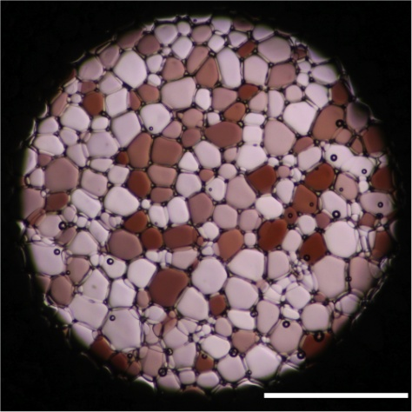
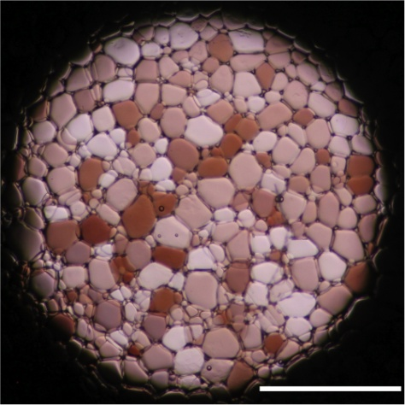
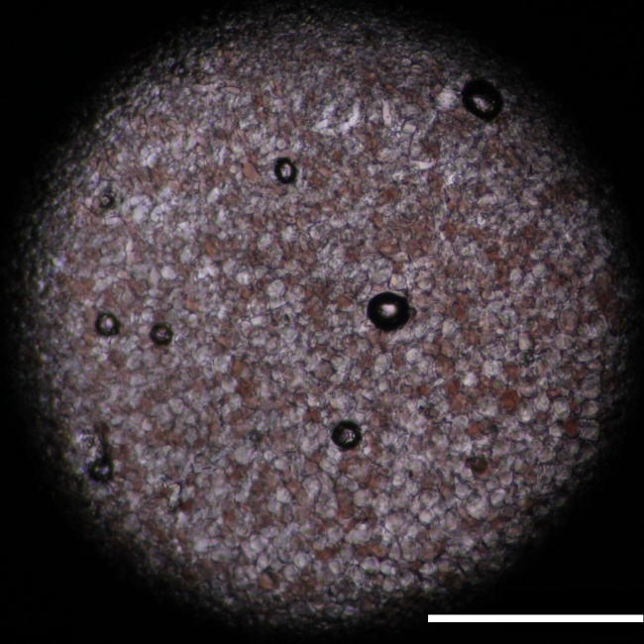
"Ice Recrystallisation Inhibition(IRI)- This slide highlights the core "activity" of our polymers, which is to slow the rate of ice crystal growth.
Left figure shows ice crystals grown from PBS buffer for 30 minutes,
Middle figure shows ice crystals grown from PBS with the addition of PEG which has no "antifreeze" activity.
Right shows the same as above but with our patented cryo-protectant which has clearly stopped the ice crystals from growing.”
Notes:
Ice Recrystallisation Inhibition (IRI) – This slide highlights the core ‘activity’ of our polymers, which is to slow the rate of ice crystal growth.
Left figure shows ice crystals grown from PBS buffer for 30 minutes,
Middle figure shows ice crystals grown from PBS buffer with the addition of PEG (poly(ethyleneglycol) which has no ‘antifreeze’ activity.
Right, Shows the same as above but with 10 mg/mL (1 wt %) poly(vinyl alcohol) (PVA) which has clearly stopped the ice crystals from growing.
(Scale bar = 500 µm)
Images taken after annealing for 30 minutes at -6°C using a modified “splat” test (1. Deller, R.C. et al, Biomater. Sci., 2013, 1, 478–485; 2. Congdon, T. et al, Biomacromolecules, 2013, 14, 1578–1586; 3. Deller, R.C. et al, Nat. Comm., 2014, 5;)
Conclusion: PVA has a very high IRI activity comparable to naturally occurring (yet hard to isolate) Antifreeze Proteins (AFPs) where as another biocompatible polymer, PEG, does not have any activity

Slide 17
VALUE PROPOSITIONS ELIMINATING SHELF LIFE OF BLOOD
Eliminate shelf life of all components of blood
Draw blood as usual no separate station for Platelets
No Glycerol which must be washed before use
No DMSO which must be washed out before use
New Protectant- Polyvinyl Alcohol(PVA) FDA approved for other consumable products and will not have to washed prior to use
Store whole blood until ready for use
Eliminate shortages for all components Globally
Our Value Proposition

Slide 18
AMERICAN ACADEMY OF BLOOD BANKING PUBLISHED IN 12-25-2016

Slide 19
WHAT IS CLC’S PROPRIETARY TECHNOLOGY?
Revolutionary advance in the science of cryopreservation of blood and its component parts, including platelets, using a proprietary process that is commercially feasible and economically superior to methods currently used in the United States and Europe
Significantly enhances the science of organ preservation and handling, thereby vastly improving the process of transplantation
Potentially broader and economic applicability to the current commercially utilized preservation process of high-end foods

Slide 20
PLATELETS
The preservation of platelets is extremely challenging
Effective shelf life is only 4-6 days…even less when the actual processing is taken into account
CLC technology will permit the effective preservation of platelets indefinitely
Preliminary testing indicates that CLC’s unique process, together with the use of the identified protectant, results in the efficacious preservation of platelets for periods far in excess of today’s standard shelf life

Slide 21
WHAT ARE THE EXPECTED COMMERCIAL APPLICATIONS FOR THE PROCESS?
Identified Commercial Applications:
Cryopreservation of whole blood for periods far in excess of current protocols used by hospitals ,donation centers and organizations at remote trauma sites. This includes military excursions in remote locations, such as submarines and space stations, all using a commercially feasible process
Cryopreservation of platelets permitting the efficacious preservation of platelets beyond the current shelf life of 4-6 days
Cryopreservation of high-end specialty food items (e.g. sushi) to prevent all of the significant disadvantages inherent in freezing food items for extended periods
Other potential extended uses of technology under investigation, including stem cells advancement and better control of contaminants

Slide 22
FUNDING NEEDS
1) Platelets $ 6,450,000
2) 21st Century licensing of PVA $ 640.000
3) Re-Freezing of unused blood–research $ 2.100,000
4) Patent Attorney for current patents $ 125,000
5) Patent Attorney for additional patents $ 125,000
6) Stem Cells $ 3,500,000
7) New Blood Storage program $ 2,120,000
8) Elimination of Blood Washing $ 2,100,000
9) Sales and marketing for intro. $ 2,840,000
-----------------------
Total $ 20,000,000
==========

Slide 23
Strategic Partners

Slide 24
In many parts of the world. Blood supply as well as efficient delivery is a challenge.
ZIPLINE has the answer to that with the introduction of DRONES
They can, in most cases deliver in most parts of Africa in 50 minutes versa several hours/days.
As we also know that 60-70% of their donated blood is contaminated.
In partnering with them we will be able to increase their supply as well as eliminated the contaminates
https://www.ted.com/talks/keller_rinaudo_how_we_re_using_drones_to_deliver_blood_and_save_lives

Slide 25
REJUVENATED MEDICINE
As science has discovered replenishing older blood with younger blood has had remarkable results with destroying diseases.
Our blood can become stale and acceptable to many different type of diseases.
Storing our blood now and having it available when and if we are diagnosed with a terminal disease.
See video:https://www.ted.com/talks/tony_wyss_coray_how_young_blood_might_help_reverse_aging_yes_really

Slide 26
FOR IMMEDIATE RELEASE….
C LEVEL CLONE ANNOUNCES THE FORMATION OF ITS MEDICAL ADVISORY BOARD AND THE APPOINTMENTS OF DR. WADIE F. BAHOU, DR.LOREN WALENSKY TO SUCH BOARD.
Boston, April 09, 2015…C- Level Clone is pleased to announce the formation of its Medical Advisory Board( hereinafter MAB). The MAB is to be comprised of recognized authorities in the medical and scientific fields with the role of providing strategic advice and counsel to the company in order to assist the company in the further development of its patented processes to improve all aspects of blood (and the key components thereof) management, preservation and efficacy, and to extend the functional utilization of traditional blood and blood component transfusions to non-traditional (ex hospital) situations.
C Level Clone is also pleased to announce the appointments of its first two members to the MAB, Dr. Wadie F. Bahou, and Dr.Loren Walenski.
MEDICAL ADVISORY BOARD

Slide 27
Dr.Walensky is associate professor of pediatrics at Harvard Medical School. Dr. Walensky received his MD and PhD from John Hopkins University School of Medicine in 1997.
He trained at the Boston Combined Residency Program in Pediatrics and then completed a fellowship in Pediatric-Hematology-Oncology at Dana Faber Cancer Institute (DFCI) and Children’s Hospital in 2003.
He joined (DFCI) in 2003 and was named medical director of the new program in Cancer Chemical Biology in 2005. He is board certified in general pediatrics and pediatric hematology-oncology.
We are extremely pleased to have Dr. Loren Walensky, join and bring his specialized knowledge and experience to the MAB in order to successfully achieve its mission.

Slide 28
Dr.Theodore (Ted) Robinson MD LMCC FRCS (C) -
Dr. Robinson is both an accomplished Medical Doctor and a successful entrepreneur and businessman. A graduate of the University of Manitoba Medical School (M.D. 1963), Dr. Robinson became a Fellow of the Royal College of Surgeons of Canada in 1972 with numerous medical degrees (M.D., L.M.C.C, F.R.C.S.), and practiced plastic and reconstructive surgery in London, England and Vancouver, Canada from 1965-2002.
Meanwhile, he also maintained a very energetic business life, serving as President of Mardan Management Ltd, (Hawaii) (1977-1986), president of Bison Petroleum (Oklahoma) (1978-1981), president of Theora Explorations Ltd (Alberta), vice - president of Omira Health Centers, and president of Stardust Holdings Ltd. (1986 – present.)
He was a consultant to Pegasus Pharmaceuticals Group for 8 years, and president of the Robinson Group, an international neutriceutical marketing company in China, Canada, and the USA from 2008 to 2013. He was the CFO of Nutrinova Neutraceutical Innovations Ltd. in Canada, the U.S., Chile and China from 2013 to 2016.
In addition to serving as a consultant to Gold Backed Bonds, Dr. Robinson has served on the board of directors of G.R. Stein & Co., a merchant banking group based in Vancouver and Brussels, a director of Transamerican Energy, a TSX company (2001-2006.), He has also been the Chief Scientific Officer of Wildflower Marijuana Inc. since January of 2015 and the Chairman of Impact International Secured Investments Corporation 2017 to present.​
In short, Dr. Robinson brings strong credentials and a wealth of business experience to the Board of Directors of Impact International Secured Investments.
Personal: Preference for working with companies that have high ethical standards and projects or products that positively impact people’s health and that of society at large. Long-standing fitness buff and sports enthusiast with an emphasis on marathon running for fitness and to raise money for many worthy causes. Most recently competed in the BC Masters Games, achieving personal bests in the 800M, 1500M and 5000M events, and 2 medals in the 800M and 1500M events. Hobbies: fitness, travel, photography, bonsai culture.

Slide 29
PATENT CRT022170

Slide 30
2nd Live interview with Radio Entrepreneurs explaining the history of the proven technology
https://radioentrepreneurs.com/2019/07/26/jimmy-walker-c-level-clone-2/

Slide 31
MANAGEMENT TEAM
http://WWW.C-LEVELCLONE.COM

Slide 32
Thank you!
http://www.c-levelclone.com/

